Slide 1
Study Abroad 101
The purpose of this presentation is to provide important information about study abroad policies and the application process. The content primarily focuses on semester study abroad, and topics include the types of programs offered, finances, academics, eligibility criteria, acceptance decisions, application deadlines and more.
Students can refer to this PowerPoint when completing the required quiz for the semester abroad application.

Slide 2
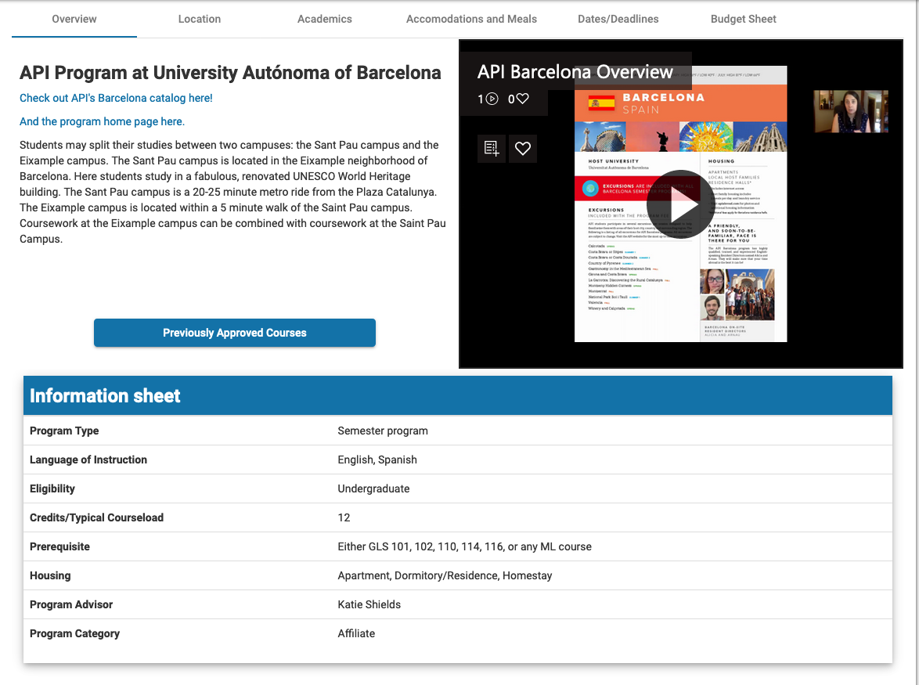
Types of programs
Partner Programs allow for studying alongside local and international students. The methods of teaching and assessment are significantly different from those in the U.S. and may include large lectures, assigned but ungraded homework, and more heavily weighted exams. Partner programs provide the highest level of academic and cultural immersion and require a great deal of self-sufficiency and independence. The support networks reflect the cultural values and style of the host university and are typically less hands-on than Bentley's administration.
Affiliate Programs are administered by highly respected study abroad organizations approved by Bentley. Students enroll in courses designed for American study abroad participants and typically follow an American model of teaching and assessment. Students may have the option to take some or all courses at foreign universities with local and international peers, in which case teaching and assessment methods are very different from those in the U.S. Affiliate programs typically offer a high level of on-site support.
To determine the program type, check out the “Program Category” found on the brochure page. See screen shot here:
View Program list

Slide 3
Finances
Tuition & Fees
Students pay Bentley University tuition for their semester abroad
Housing costs vary by program; in some cases housing is billed by Bentley while in others it is billed by the study abroad program/university directly
Students pay an administrative fee of $500
A “budget sheet” can be found on each program’s webpage and contains estimates on tuition, room & board, international health insurance, and other extra fees
Personal expenses may include travel, books, visa, etc. and vary widely by program
Financial Aid
Students may apply federal, state, local & Bentley aid to a semester abroad
Bentley aid is guaranteed for 1 semester only
Scholarships
Gilman Scholarship (for Pell Grant recipients only)
Other scholarships available for students on programs through IES, API, CIEE, Semester at Sea, The Alliance for Global Education and The American College of Thessaloniki
The Julius E. Babbitt Study Abroad Scholarship
Robert Alan Study Abroad Scholarship (For STEP students only)
Many more scholarships are available, some of which can be found on our website, so do some research!

Slide 4
Academics
Save elective courses for your semester abroad; this allows for more flexibility in course selection abroad
Major courses are not guaranteed but it may be possible to take them abroad
Previously Approved Courses can be found on each program’s webpage
As shown here →→→
the list displays the course abroad as well as the Bentley equivalency. Click on the small blue arrow (circled), and the Bentley equivalency will appear in a dropdown.
Course approval process
All course syllabi must be reviewed by Bentley faculty to determine eligibility for credit. In order to get a course reviewed, you must send the syllabus to your study abroad advisor.
Credits & Grades
Students studying abroad in Bentley partner and affiliate semester programs earn Bentley credits and Bentley grades for all approved courses. If the host institution utilizes a different grading system, grades will be translated to the A-F system according to Bentley’s equivalency scale. The Bentley transcript will show the term abroad with all approved course titles, Bentley credits, and Bentley grades in the A-F system. The grades from abroad will not be factored into the Bentley GPA.

Slide 5
Academic Planning Planning ahead helps to ensure that your semester abroad fits in seamlessly with your graduation requirements.
Make sure you have declared your major before you apply.
Check out and understand your Degree Works Audit!
Remember to research the academics of your study abroad programs of interest and consider how they fit in with your Bentley degree requirements.
If accepted to study abroad, you will map out your remaining academic requirements by completing a Plan of Study. This allows you to better understand your degree requirements and how study abroad will impact your academic progression. More info on Plan of Study can be found on the next slide.

Slide 6
Plan of Study Requirement
Undergraduate Academic Services and the Office of International Education will provide you with information, materials, and support to develop your official Plan of Study.
Academic Advisors in Undergraduate Academic Services will review and approve your Plan of Study.
You will receive more information about creating your Plan of Study during the application process.
We strongly suggest you become familiar with Degree Works and attend an “Academic Planning for Study Abroad” info session to ensure you will be able to fit a semester abroad into your academic requirements and complete your Plan of Study.

Slide 7
Eligibility Criteria
3.0 Strongly recommended
Certain programs require 3.0
Applicants with a GPA below 3.0 should meet with an advisor to discuss program options prior to submitting an application. A GPA of 2.5 is the minimum for consideration.
Declared Major
Good academic & judicial standing
Pass one of the following prerequisite courses:
GLS 101, 102, 110, 114, 116 OR any Modern Language course

Slide 8
Acceptance Decisions
We have hard decisions to make! Here’s what we consider:
Do you meet the requirements? (refer to “eligibility criteria” slide)
Did you write high quality essays?
Did you receive a good faculty recommendation if applicable?
Some programs require a faculty recommendation. You will see this as part of the application criteria when you begin an application. Don’t forget to ask your professor if they will complete your recommendation before entering their name in your online application!
Does your preferred program have limited spots available?
Have we achieved a balance between fall and spring?
All students should thoughtfully consider their second and third choice programs
High demand programs are not recommended for a second or third choice. These programs include API in Barcelona, Universidad Pontificia Comillas in Madrid, Bond University in Australia, Lorenzo de’Medici in Florence, IES Milan, and Semester at Sea.
Please note: You can only submit ONE application per term. You do not need separate applications for your second & third choice programs.
Be open to studying abroad without your friends
Our priority is always to give students their first choice program and semester, but it’s not always possible. It’s important to be open to other programs and to consider your goals for study abroad independently from those of your friends.

Slide 9
Housing @ Bentley before & after study abroad
Students studying abroad in the fall will be placed in open individual spaces in on-campus housing in the spring
The Office of Residential Life cannot guarantee that students will live with their friends upon their return to Bentley
Contact the Office of Residential Life with questions
Students studying abroad in the spring will select their housing and roommates for the fall semester through the normal housing process

Slide 10
Internship/job search
Many students are able to secure internships from abroad for when they return home. Here are some ways to do that:
Start planning early
Connect with Career Services for advising before studying abroad
Research Bentley alumni network in your host country to make connections before you go
Familiarize yourself with the recruiting season for your particular field
Some students think on-campus recruiting only happens in the spring when in reality many companies begin their on-campus recruiting in the fall
Interview via Skype/Zoom from abroad
Consider getting an internship abroad
Many programs offer internships for credit which can be completed alongside academic coursework

Slide 11
Dates & Deadlines
Faculty-led International Courses
January course application deadline: September 30th
March course application deadline: October 31st
May course application deadline: February 2nd
Application Opens | October
Fee Waiver Semester/Summer Application Deadline | January 5th
Final Semester/Summer Application Deadline | February 2nd
Final Application Decision Announcement | February 23rd

Slide 12
Next steps
Do you have further questions?
Visit our website
Attend drop-in hours for quick, general questions
Attend an info session
Set up a meeting with an advisor
Keep your family in the loop & share this presentation
Start an application in BentleyAbroad
The application opens in October
All students are required to take the Study Abroad 101 quiz as part of the semester application process. Students may use this PowerPoint for reference when completing the quiz.

Slide 13
THANK YOU Cronin Office of International Education Adamian 161 781-891-3474 GA_Study_Abroad@Bentley.edu

