Slide 1
Workday Adaptive Training (Budgeting and Forecasting)
By Office of Financial Planning and Budgeting
December 2021

Slide 2
Agenda
01
Workday Adaptive Overview
06
Reporting
02
How to Access Adaptive Planning
07
Adaptive Demo
03
Navigation and Sheets
08
Questions
04
Operating Budget Planning
05
Operating Forecast Planning

Slide 3
Workday Adaptive Overview
01

Slide 4
Workday Adaptive Overview
Bentley is undertaking the first phase of Workday Adaptive Planning, a replacement of our existing Workday Planning module which is a result of Workday’s acquisition of Adaptive Insights. As a Workday institution, Bentley was forced to migrate to this new technology platform this fiscal year as our legacy product was decommissioned. The Office of Financial Planning & Budgeting is currently implementing this new enterprise performance management (EPM) software with Workday consultants and anticipates a go-live date at the end of calendar year 2021.
Adaptive Planning provides:
Budgeting
Forecasting
Reporting
Analytics
Integration with Workday
Security

Slide 5
How to Access Adaptive Planning
02

Slide 6
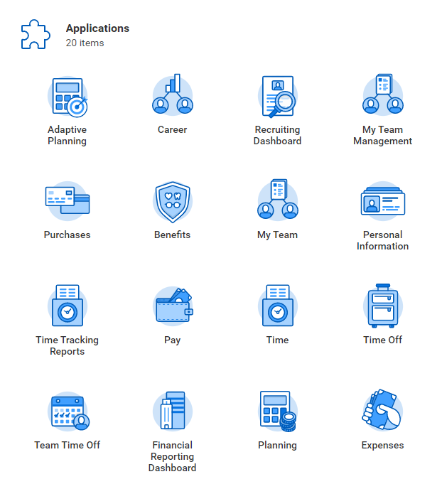
How to Access Adaptive Planning
Log into Workday, then click on the Adaptive Planning worklet on your home page

Slide 7
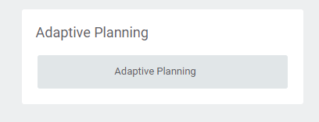
How to Access Adaptive Planning
Next, click on the grey Adaptive planning box

Slide 8
Navigation and Sheets
03

Slide 9
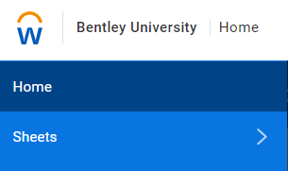
Sheet Navigation
Click on the Workday Logo to access sheets available for entry

Slide 10
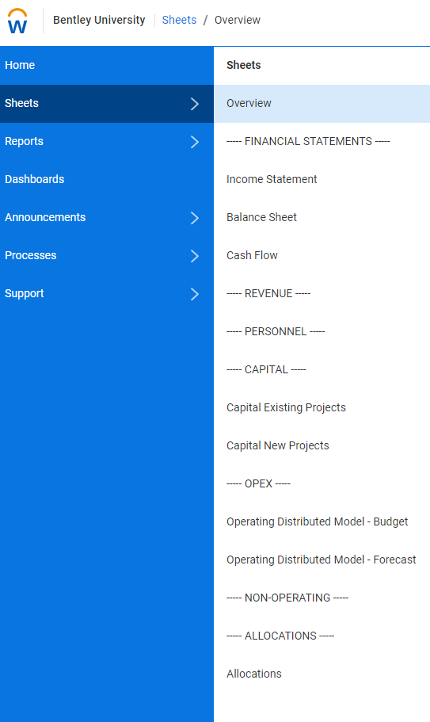
Sheet Navigation
2. You should have access to "Operating Distributed Model –Budget" and "Operating Distributed Model - Forecast." Click on each to ensure access to both sheets
*Note: There may be sheets that show up with restricted access. The only sheets needed for Budget and Forecast will be available for cost center planners

Slide 11
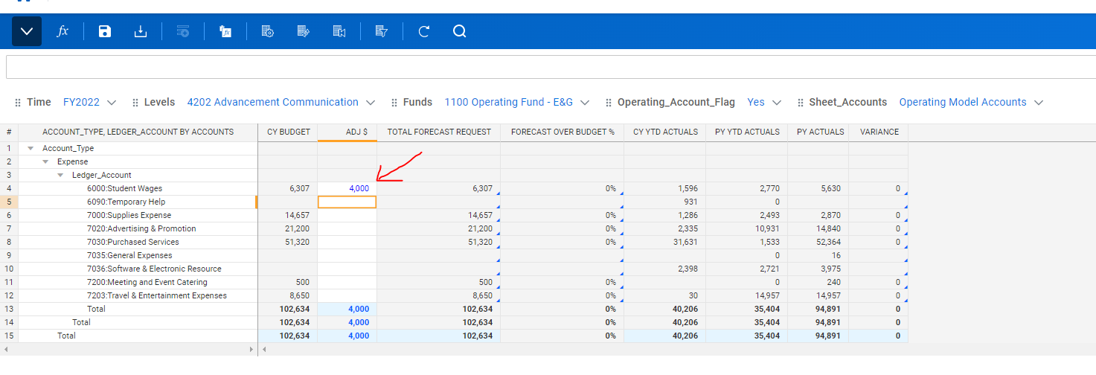
Entering Changes in Adjustment Column
All columns that are grey are locked and cannot be changed. Data can only be entered in the white cells within the ADJ $ column and will be in blue font until you hit the save icon.

Slide 12
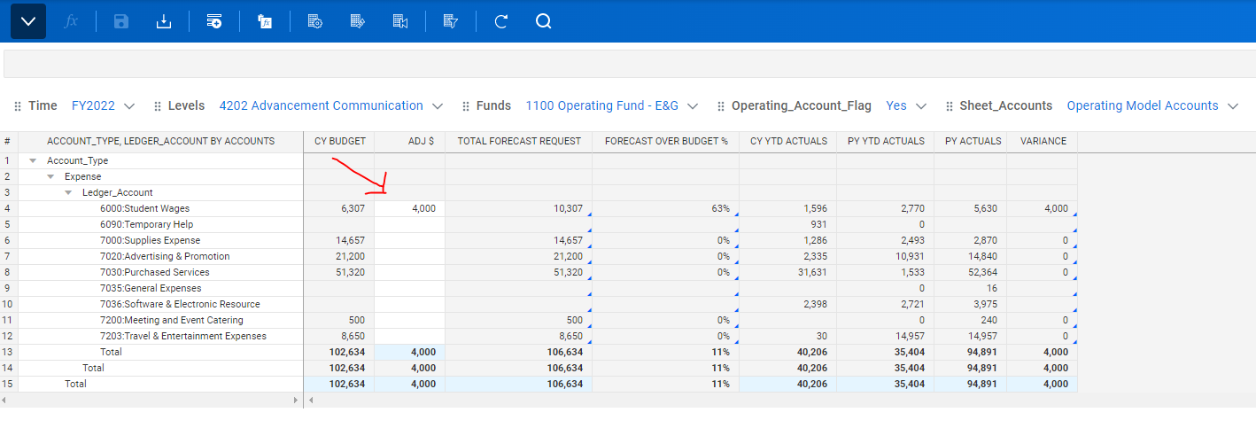
Entering Changes in Adjustment Column
If you do not click the save icon before navigating to another sheet or cost center, the changes will not be captured. The below example has $4,000 Adjustment in Student wages, once you click the save icon the font color turns from blue to black.

Slide 13
Operating Budget Planning
04

Slide 14
Operating Budget Adaptive Planning
Access Adaptive Planning through your Workday Applications. Log into Workday, then select the Adaptive Planning worklet
Select the Adaptive Planning button
Navigate to the Workday logo on the top left of your screen
Select "Sheets" then "Operating Distributed Model – Budget" under OPEX
Before beginning, please ensure the parameters on the sheet are set as follows:
a. Version (in the top right of your screen): Next fiscal year (FY2023 Budget)
b. Time: Next fiscal year (FY2023)
c. Levels: Cost Centers on which you are assigned Cost Center Planner
d. Funds: 1100 Operating Fund – E&G
e. Operating_Account_Flag: Yes
f. Sheet_Accounts: Operating Model Accounts

Slide 15
Operating Budget Adaptive Planning
To only display rows which have a budget amount or actuals activity, select "Display Options" and check the “Suppress rows if all zeros or blank” box
"The Operating Distributed Model – Budget" sheet allows for reallocation of budget amounts between ledger accounts as well as non-reallocation additions and reductions to the budget
To start, change the "Levels" parameter to a specific cost center. In the sheet, the “Starting Plan (Superuser) ” column displays the current budget for the next fiscal year. To enter any adjustments to your budget, enter values in the cells shaded in white in the “ADJ $” column. Attempting to enter data in other cells will cause the following error message “Locked: Linked account” which indicates that data cannot be accessed or changed

Slide 16
Operating Budget Adaptive Planning
Once you’ve entered your adjustments, the value in the “ADJ $” column will appear in blue font. To save your changes, select the Save button . Once saved, your adjustments will appear in black font and the “Total Budget Request” column will be updated to include Starting Plan + ADJ $
For each addition/reduction entered, please add an explanation. Do this by right clicking on the cell and selecting “Add Note”. Once you’ve entered your note, click OK. You can also add a note to the entire sheet by selecting the “Add Sheet Notes” button on the top right of your screen

Slide 17
Operating Forecast Planning
05

Slide 18
Operating Forecast Adaptive Planning
Access Adaptive Planning through your Workday Applications. Log into Workday, then select the Adaptive Planning worklet
Select the Adaptive Planning button
Navigate to the Workday logo on the top left of your screen
Select "Sheets" then "Operating Distributed Model – Forecast" under OPEX
Before beginning, please ensure the parameters on the sheet are set as follows:
a. Version (in the top right of your screen): Current fiscal year forecast (FY2022 Jan Forecast)
b. Time: Current fiscal year (FY2022)
c. Levels: Cost Centers on which you are assigned Cost Center Planner
d. Funds: 1100 Operating Fund – E&G
e. Operating_Account_Flag: Yes
f. Sheet_Accounts: Operating Model Accounts

Slide 19
Operating Forecast Adaptive Planning
To only display rows which have a budget amount or actuals activity select "Display Options" and check the “Suppress rows if all zeros or blank” box
"The Operating Distributed Model – Forecast" sheet allows for reallocation of budget amounts between ledger accounts as well as non-reallocation additions and reductions to the budget
To start, change the "Levels" parameter to a specific cost center. In the sheet, the “Starting Plan (Rename) ” column displays the budget for the current fiscal year. To enter any adjustments to your budget, enter values in the cells shaded in white in the “ADJ $” column. Attempting to enter data in other cells will cause the following error message “Locked: Linked account” which indicates that data cannot be accessed or changed

Slide 20
Operating Forecast Adaptive Planning
Once you’ve entered your adjustments, the value in the “ADJ $” column will appear in blue font. To save your changes, select the Save button . Once saved, your adjustments will appear in black font and the “Total Budget Request” column will be updated to include Starting Plan + ADJ $
For each addition/reduction entered, please add an explanation. Do this by right clicking on the cell and selecting “Add Note”. Once you’ve entered your note, click OK. You can also add a note to the entire sheet by selecting the “Add Sheet Notes” button on the top right of your screen

Slide 21
Reporting
06

Slide 22
Reporting
Access Adaptive Planning through your Workday Applications. Log into Workday, then select the Adaptive Planning worklet
Select Adaptive Planning button
Navigate to the Workday logo on the top left of your screen
Select "Reports"
Select "Shared" and click on the "Mock Up Reports" folder
To view your requested budget by ledger account, select the "Expense Budget Summary by Ledger Account" report
In the "Level" dropdown, select the cost center you would like to view and then click "Run Report"

Slide 23
Reporting
To view this report for another cost center, select the cost center in the "Level" dropdown in the top left of your screen, and then click on the Run Report button
To view your requested budget by cost center, select the "Budget Summary by Cost Center" report
To view your requested forecast by ledger account, select the "Forecast Summary by Ledger Account" report
To view your requested forecast by cost center, select the "Forecast Summary by Cost Center" report

Slide 24
Adaptive Demo
07

Slide 25
Questions?
08

